Slide 1

What’s the Move? –
Scenario Analysis
Phillip Stratos, Chris Jones, and Matt Chamberlain
Notes:
Goals and concerns

Slide 2

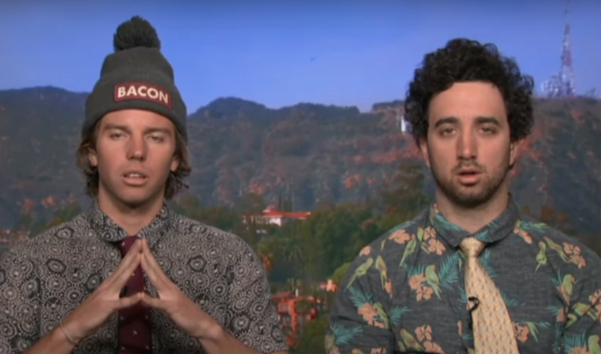
Scenario 1 - Chad and JT
Chad and JT are both JMU students on a fixed income and have had a very busy week. They have caught up on all their studies and are now trying to go out.

Slide 3
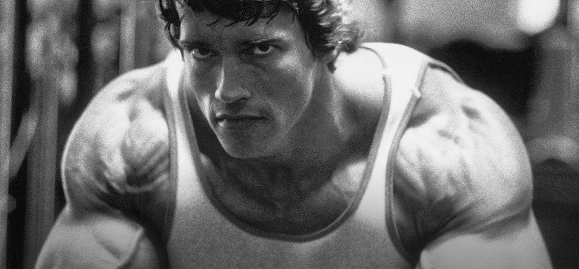
Scenario 2 - Mark Sanchez
Mark just moved from Canada to Harrisonburg and he is having a hard time meeting new people. What's the move?

Slide 4
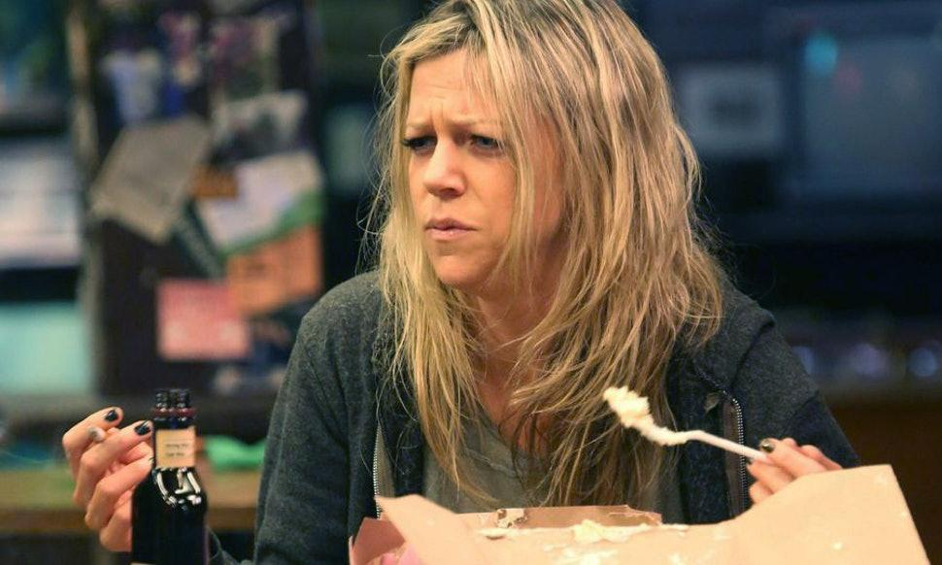
Scenario 3 - Deandra Reynolds
Deandra Reynolds is business owner in the Harrisonburg area. She owns the bar Finnegan’s Cove and is having a hard time getting customers to her location.

Slide 5
To Conclude...
What’s The Move? is by the people, for people
What’s The Move? will help you find the best happy hour deals around, introduce you to new places, people, and experiences in the JMU surrounding area
The App that all students need in their life

